Slide 1

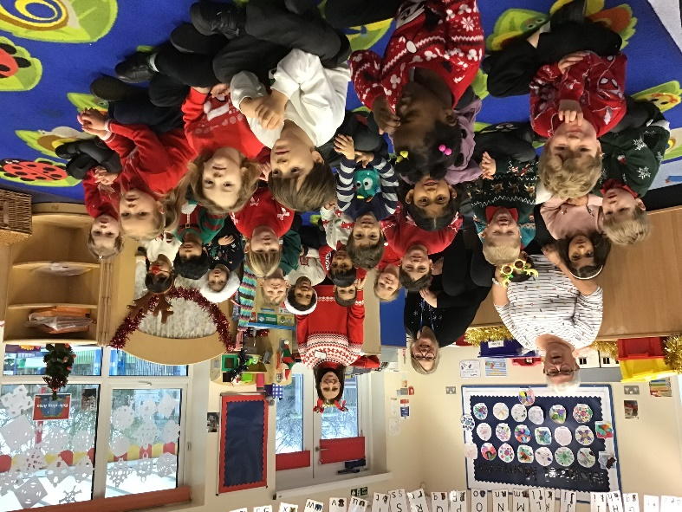
Welcome Reception
Red Class
September 2026

Slide 2
Red Class Team
Teachers:
Mrs Lione
Mrs Duncombe
TA: Mrs Gibbs

Slide 3
School Admin
  Parentmail
  Uniform
  Car Parking, gates, hi-viz
  Milk & lunches
  Free school meals
  EAL
  Illness & medication

Slide 4


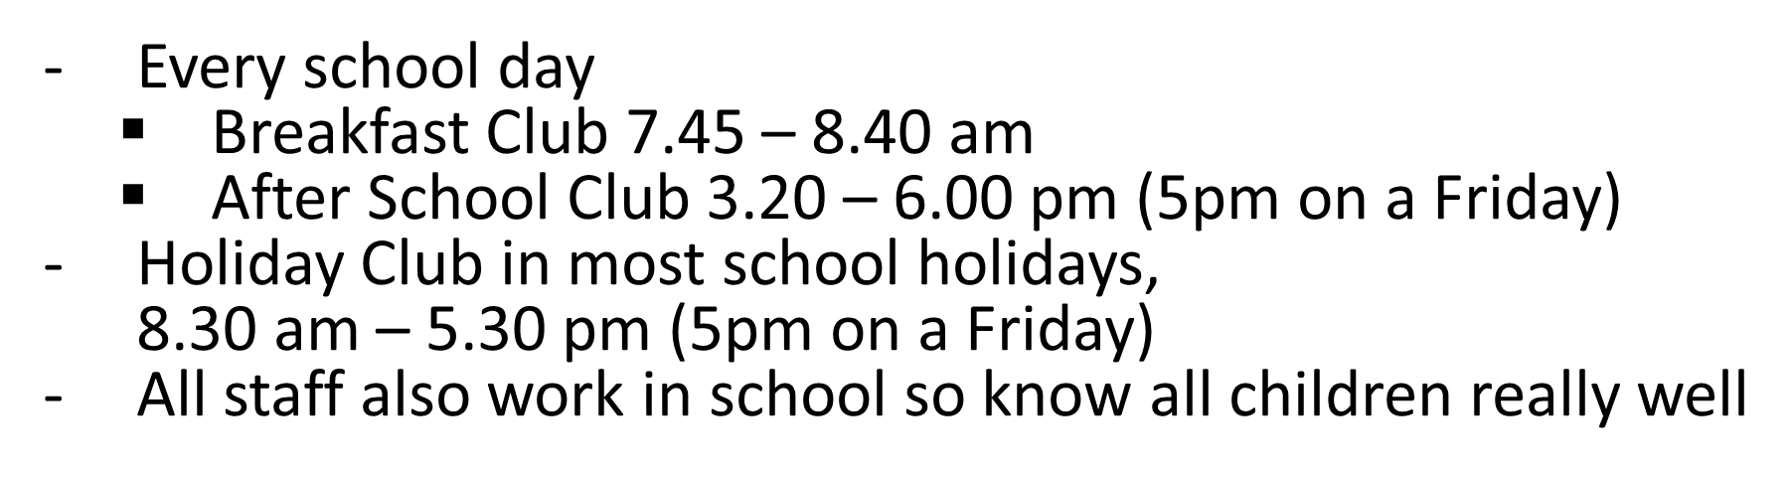

Slide 5
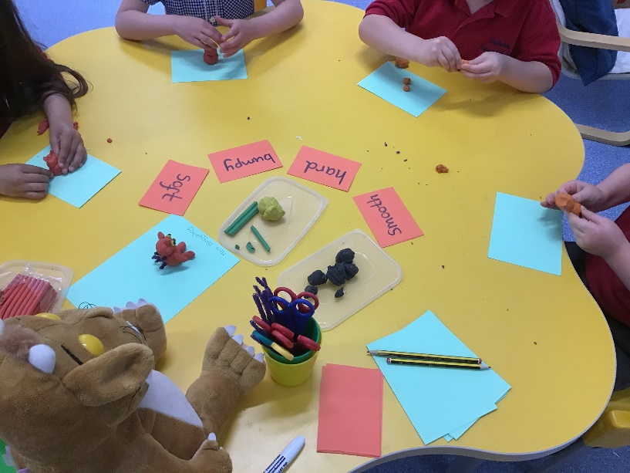
How does Reception work at Caldecote?
During the morning we do short whole class sessions for Phonics, Literacy and Maths.
Within these sessions we have guided groups led by both the Teacher and Teaching Assistant (TA) and independent activities.
Throughout the day pupils can access both inside and outside provision.

Slide 6
Afternoon Sessions
Pupils will learn through a topic/theme covering a range of curriculum areas, ensuring knowledge and skills from the EYFS curriculum are covered.
For example the topic ‘Where do they live?’ might cover:
Learning about farm animals, woodland creatures and minibeasts
Singing songs about animals / creatures – Old MacDonald, Incy-Wincy Spider, etc..
Painting pictures of a woodland scene
Making plasticisene models of animals
Using resources to build a home for an animal – Duplo, junk modelling, etc...
Visiting a farm
Range of activities – adult led group, independent group, child initiated
- planned and resourced continuous provision

Slide 7
How do we know your child’s capabilities?
Observing children playing
Small group activities
Talking and questioning
Class/group discussions
Communication with parents/carers
On-going dynamic assessment

Slide 8

Assessment
We do an ‘on-entry’ assessment using observation and information from parents/carers and Nursery/Pre-School
The DfE Reception Baseline assessment will also be completed
During the year there will be 2 parent consultations (Autumn and Spring) where you will meet with teachers to discuss progress and well being and also receive a progress report
At the end of the academic year you will receive an Annual Report informing you of your child’s attainment and where they are in relation to the Early Learning Goals (ELGs) and whether they have made a Good Level of Development (GLD)

Slide 9
Beginning of the School Day
Playground gates are open from 8.40am
School doors are open from 8.40am – 8.50am
Red Class come in through their own gate
Please encourage your child to be independent and say
“Goodbye” to them at the red class gate
If you have a message for the teacher, please tell the
member of staff wearing the hi-viz jacket at the gate

Slide 10


End of the School Day
Please wait on the playground, near Red Class gate
The children will come out at 3.20pm
If you need to speak to the teacher, please wait until all the children have been seen out safely to the correct adult

Slide 11
Playtime
The whole school have a morning play time together
on the main playground.
Red Class have their outside area to stay and play in if they wish to do so.
Fruit and milk is provided by the school and these are given just before morning break at ‘snack time’.
If you wish your child to have a different snack, please see the School’s Healthy Snack list and send this in your child’s bag.
Red Class have an afternoon play together with Blue Class (Y1) and Yellow Class (Y2).

Slide 12
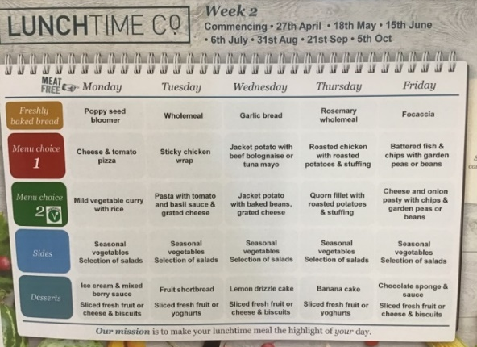
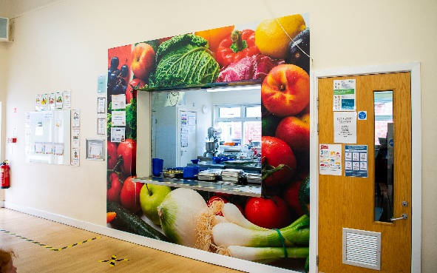
Lunchtime
Reception children are entitled to a free hot school meal. Menus can be found on school website
Play equipment is out to play with every lunchtime
Y5 and 6 Playtime Ambassadors are on the main playground and the field to support younger children with their games
Play Leaders help children play together
Y6 buddies are also available to play with

Slide 13

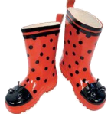
Things to have in school
Children need to bring a named bottle of water with them everyday (it must be water and not squash or any type of juice)
We go outside in all weathers so please can they have an all-in-one suit or a waterproof jacket and wellington boots to be left in school

Slide 14
PE Kit
Worn to school on PE days (day TBC but will be communicated)
Indoor – navy/ black shorts and red t-shirt
No earrings or jewellery
Long hair must be tied back
Everything must be named in an obvious place!

Slide 15
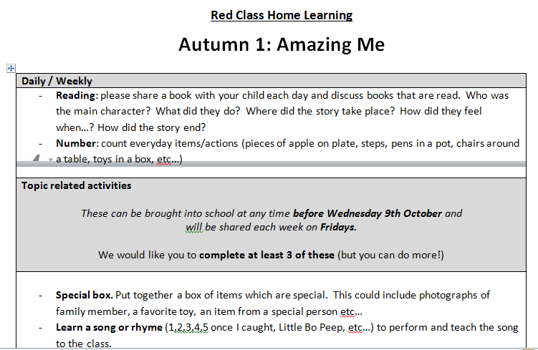
Home Learning
Each half term we have a ‘home-learning menu’
Pupils are expected to complete at least 3 of the tasks but you can do more!
Completed tasks are sent into school and/or uploaded to Seesaw as/when you compete them.
Pupils are given the opportunity to share their home-learning with the class.

Slide 16

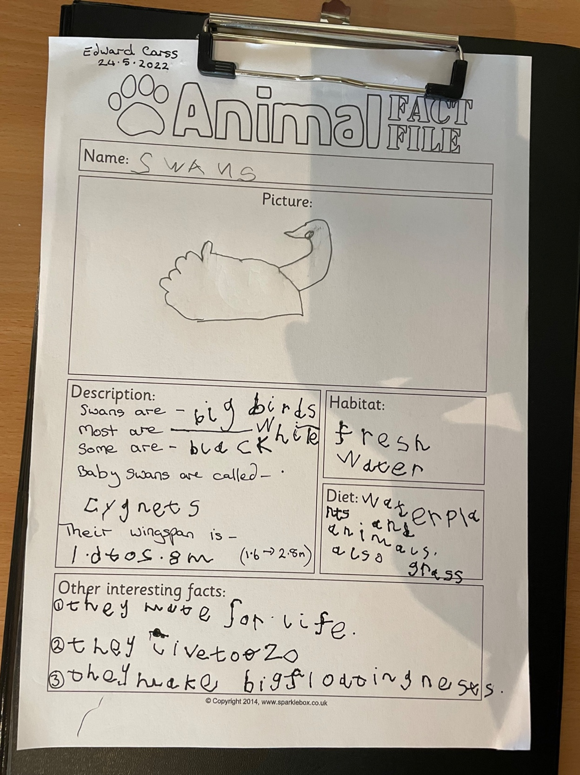
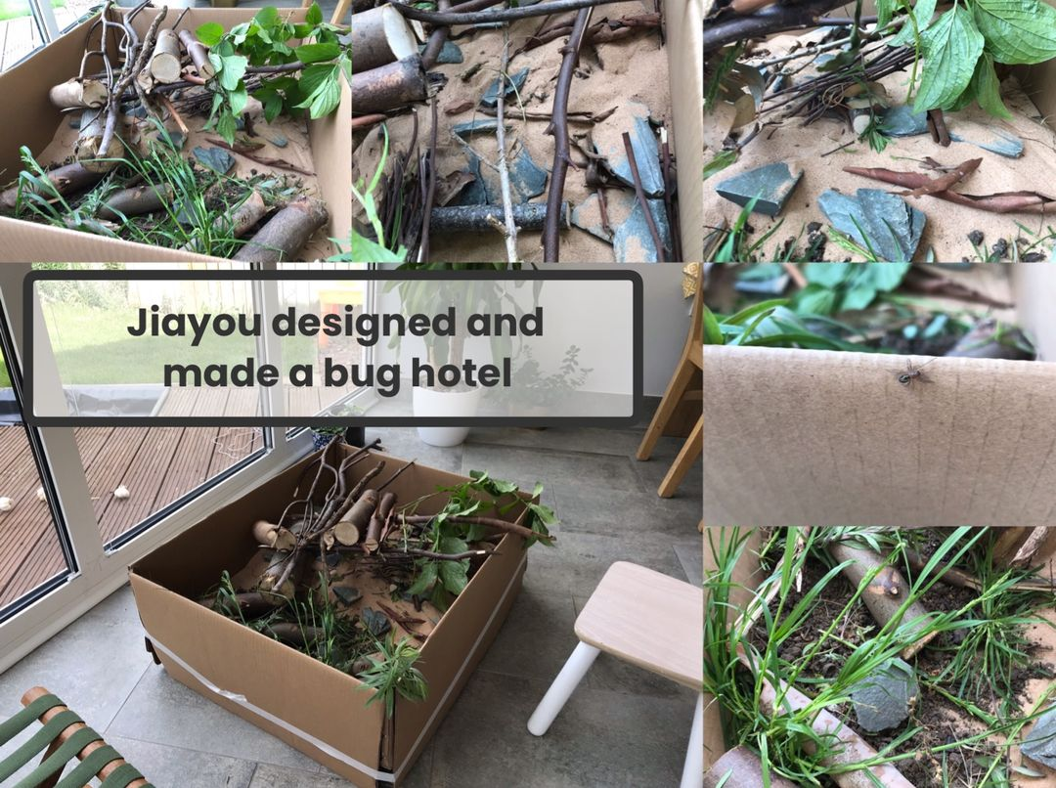
Seesaw
We use the educational platform called ‘Seesaw’ where every pupil has their own individual account.
Parents are able to:
Upload any learning children do outside school
Access a bank of activities to support home learning

Slide 17

Communication
School use Parentmail for all email communication, regular newsletters and the website.
Parents can use:
Hi-viz at the gate every morning for messages for the teachers
Emails to the office, eg absences, meeting requests
Messages can also be passed via Care Clubs’ staff
For urgent responses, you can telephone the office

Slide 18

Summer Fun
https://cambspboro.50thingstodo.org
Pre-academic ability;
Language
Curiosity
Emotional security
Self-management
Interactions with others
Nursery rhymes https://www.littlewandlelettersandsounds.org.uk/resources/for-parents/#tabnametabNurseryRhymes-Videos
Notes:
50 Things to do Before You’re Five is a mobile app that gives parents and carers 50 fantastic experiences to share with their children to help develop their confidence, language and vocabulary and to support them in being ready for the next stage in their education.
The 50 activities are low or no cost experiences that include indoor, outdoor, seasonal, home-based, and out-and-about activities that are not only fun but will get your little one off to a flying start with their learning and language development.
Each experience has been suggested by parents, carers and professionals; sifted, developed, and written up by early years experts and language specialists, to create a fabulous resource for every child under five and the grown-ups in their life!
Cambridgeshire and Peterborough parents/carers can download the app from the Apple App Store, Google Play.
If you’re not able to access the internet regularly or would like to record which of the 50 Things you have done on paper, we have a booklet available to download here:

Slide 19
Any Questions?

