Slide 1
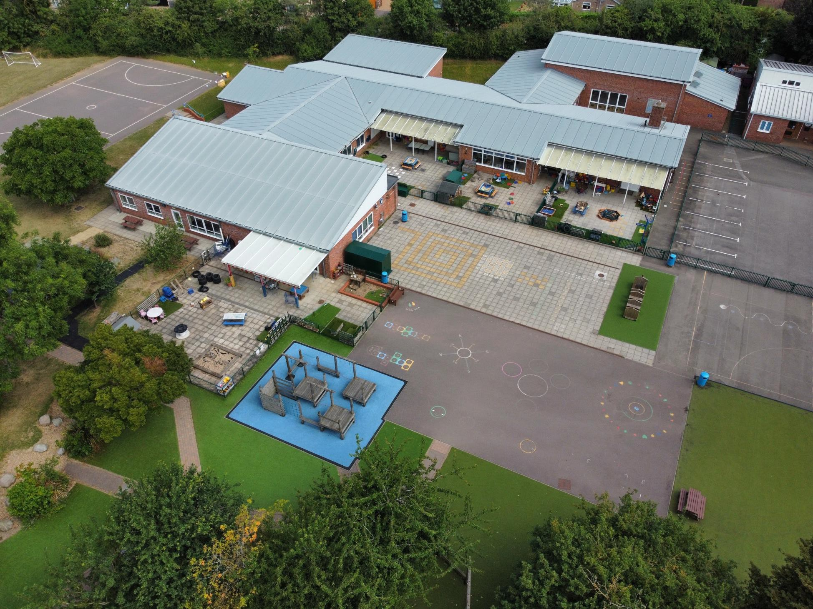
Reception Class 2026
Welcome to Caldecote Primary School
This Welcome Pack is a joint project between the parents and the school to provide you with practical information which will help when your child starts in Red Class (Reception).
Starting school is an exciting time but we understand that it can be a daunting time for both parents and children too. We hope this pack with help to answer some of your questions and reassure you.
If you feel that there is anything missing that would be useful, please let us know so that we can include it and help other new parents.

Slide 2
Pack contents
Uniform and Bags PE kit
Other clothes Food and Drink
Practical information Your child’s day
Staff and consultation
Expectations
School clubs and activities How to get involved
Red Class checklist Term Dates 2026-27 Useful forms and links
How to contact us

Slide 3
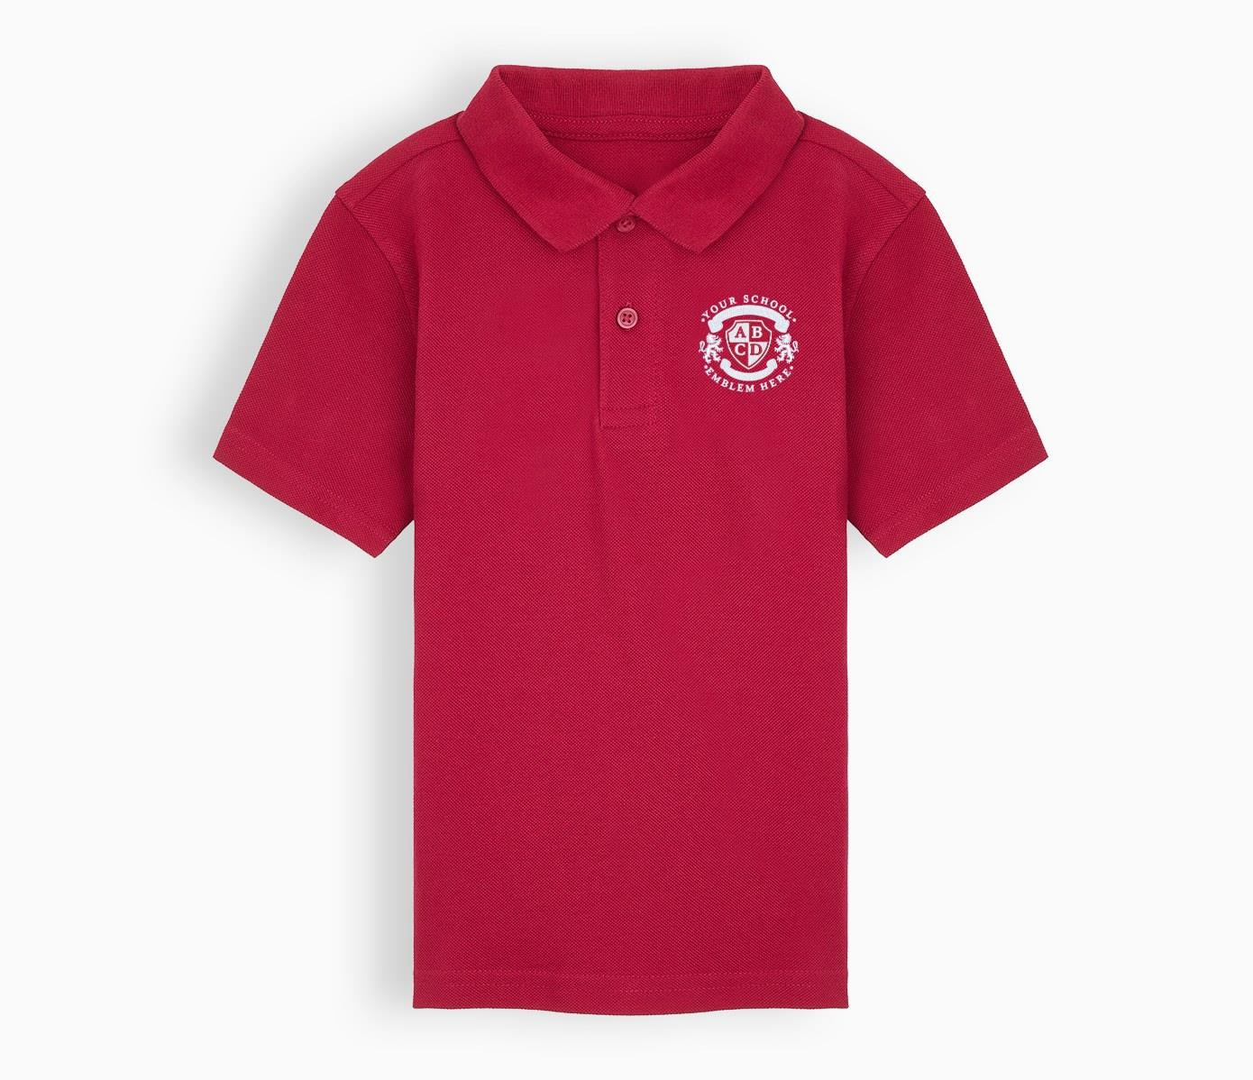
Uniform and Bags
Uniform -
Red polo shirt with embroidered school logo and name
Blue hoodless sweatshirt or fleece with embroidered school logo and name, or a navy cardigan Black, charcoal or navy school trousers or shorts
Black, charcoal or navy skirt or pinafore
Black shoes or plain, practical, single coloured sandals (white, navy, blue, black or tan) Blue gingham dress for summer
Black, grey or white socks or tights (plain)

Slide 4
Plain hair band/headband in school colours
Clothing with the school logo is optional but preferred and can be purchased from http://www.yourschooluniform.com/schools/index/caldecote-primary-school-cambridgeshire
or https://myclothing.com/ . It can be ordered at any time during the school year and will be delivered to your home; it usually takes 2-3 weeks for uniform to arrive.
Please make sure that every piece of uniform and equipment that your child brings to school has a name clearly written or securely attached to it. This includes shoes, water bottles, snack boxes, lunch boxes, book bags, rucksacks or bags and PE kit. Name tags can be purchased from companies such as nametag-it.co.uk. Any un-named lost property is collected in the ‘Lost Property Box’ which can be found in the school foyer by the main office.
Boots should not to be worn in school; if your child wears boots to school due to cold or wet weather, please bring school shoes to change into. Your child must be able to do their shoes up themselves. Please also try to make sure children can do up the zip on their coat before they start in Red Class.
Please send a jumper/cardigan and a waterproof in every day, even if your child is not wearing them when they arrive as we will always be doing outdoor learning every day, despite the weather.
The PTA holds regular sales of second hand uniform – look out for the notices in the newsletter. You can contact the PTA via the school office or pta@caldecote.cambs.sch.uk.
Bags & Books
Your child will need a named book bag (it doesn’t have to be with a school logo but should be flat to fit in the school book box – rucksacks are not suitable). This must be clearly named by an adult. It is useful to put a coloured ribbon or a keyring on the handle so your child can easily recognise their book bag.
Please do not put water bottles in the book bag because they can leak onto the books (if unavoidable, please put the bottle in a carrier bag).
If your child also needs to bring a bag or rucksack please ensure they are small as we have limited space on the cloakroom pegs to store them.

Slide 5
PE Kit
Children must come to school dressed in their PE kits on their PE days. The team will let you know what days the class will be having PE.
For PE your child will need to wear the following:
Red crew-neck t-shirt (preferably printed with school name)
*Navy/black shorts (no logos or football shorts)
*Navy sweatshirt (can be school sweatshirt)
*Navy jogging bottoms, plain without any patterns or logos
Trainers in plain black or white – children must be able to put their trainers on and off themselves
Hair must be tied back in a plain band (if required)
*These are weather dependent – remember your child will be wearing them all day and weather can change
Other Clothes
Sporting events: when we hold intra-school events eg sports day, your child will be asked to wear a top in their house colour (red, blue, green or white). Houses will be allocated in the first weeks of term and siblings will be put in the same house.
For school performances, you may be asked to provide your child with a basic item of costume
e.g. a black t-shirt and dark coloured trousers/leggings.

Slide 6
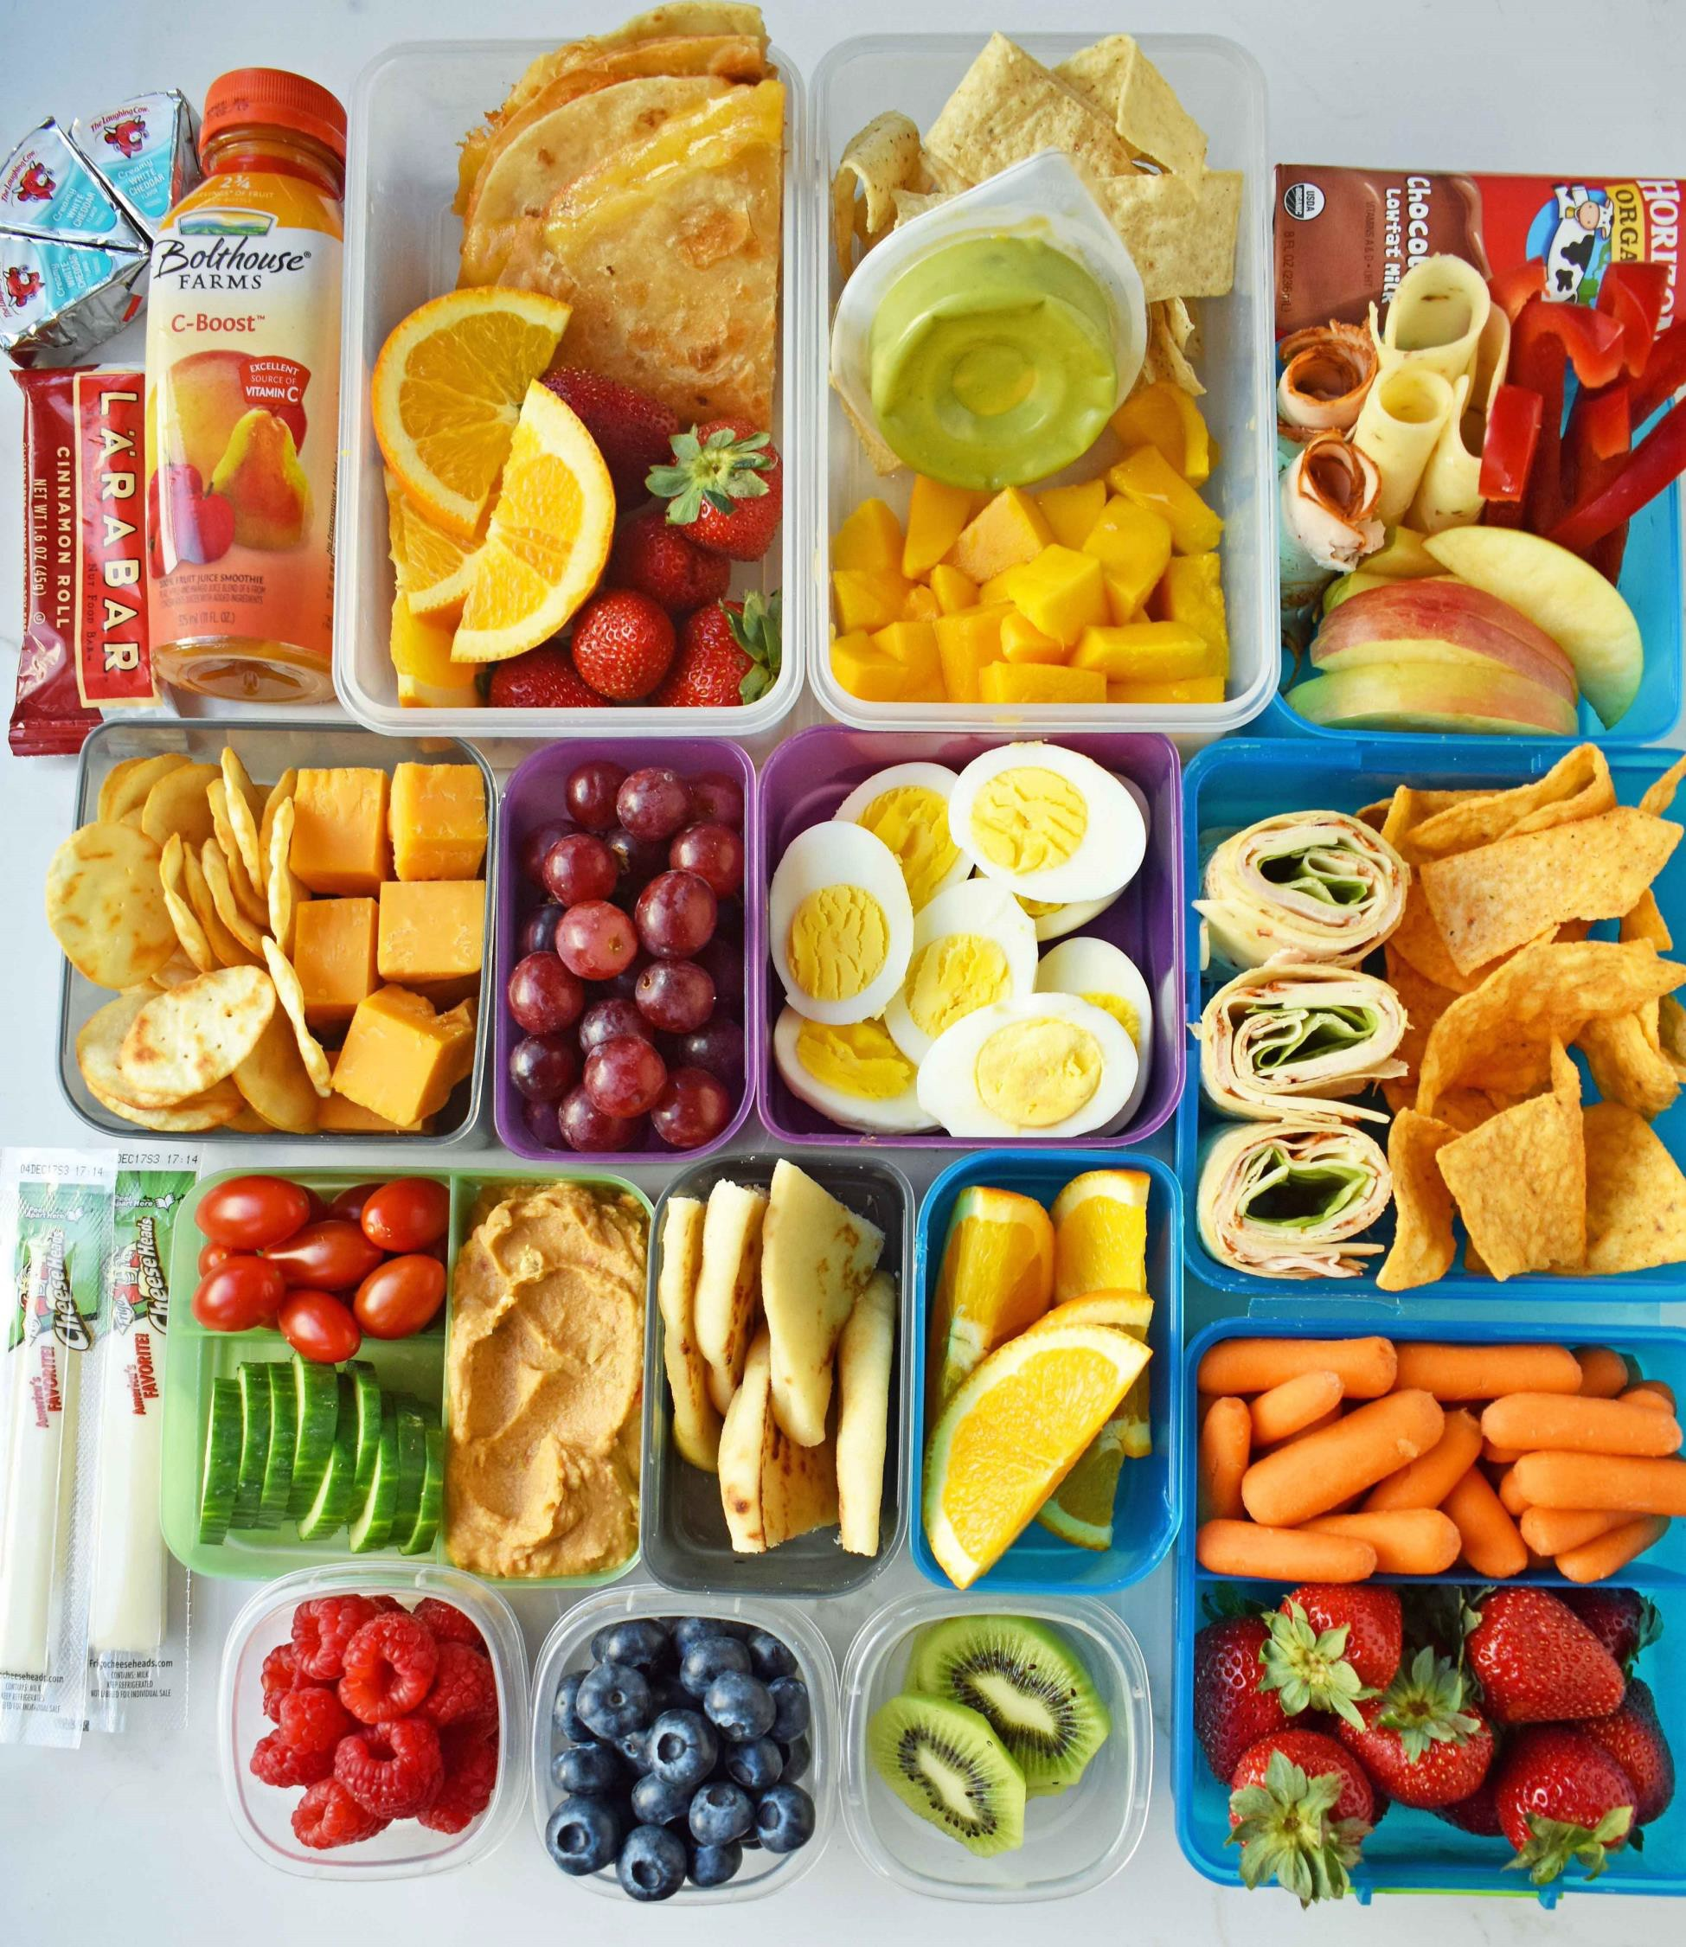
Food and Drink
Please provide your child with a named water bottle which contains only water (i.e. no flavoured water, squash or fruit juice). This should be in addition to the drink in their lunchbox. All children have free access to their water bottles in the classroom, jugs of water in the lunch hall and a water fountain at break times.

Slide 7
Snack
Snacks are eaten during morning break. In Reception and Key Stage 1 healthy snacks are provided for the children (fruit or vegetables); however, you may send your child in with a small, named, snack from our healthy snack list below if you prefer:
Fresh Fruit
Vegetables
Cheese 20g max (unprocessed e.g. not cheese strings)
Plain crackers (no spreads)
Plain rice cakes
Dried and freeze dried fruit
Plain popcorn
Milk
All children are offered free milk every day until they are 5 years old. Once they are 5 they can continue to receive milk but parents will need to order and pay for this in advance. Milk is supplied to us at school by Cool Milk. Here is a link to their website if you would like more information or wish to place an order. Cool Milk orders for over 5's
Milk is also free for pupils in all year groups who are in receipt of Free School Meal/Pupil Premium funding.
Lunches School lunches
Red, Blue and Yellow Class children are automatically entitled to Universal Infant Free Schools Meals. School lunch menus are available on our website and on display in the school foyer.
Please make sure your child knows what they are having for lunch (school meal or packed lunch from home) so they can tell the teacher at registration. You do not need to pay for or book school lunches in advance.
Packed lunches from home

Slide 8
Please don’t send your child with too much food; they may feel they should eat it all and spend a long time trying to do so.
Please use containers and water bottles which your child is able to open, be mindful of the effect of opening yoghurt, tubes or pouches and practice at home first if needed - staff will be on hand to help but we encourage independence.
In summer, you may wish to put an ice pack or frozen drink in the lunchbox to keep the food cool.
The school actively works to promote healthy eating and lifestyles so lunchboxes must not contain:
X Chocolate
X Sweets
X Fizzy drinks
X Crisps
X Nuts (because of allergies)
Practical Information
In the mornings, children will arrive either via the Village Hall gate or via the gate over the bridge (on to Highfields Road).
Parents are politely requested not to park on the road outside the school, even for a short time, as it makes it extremely difficult for children to cross the road safely. Whilst using the Village Hall car park, please drive extremely carefully and, if walking, use the designated pathways – don’t walk or cross the car park. The school car park is strictly for members of staff only. Please remember that children are much shorter than adults and cannot see or be seen over parked cars. This makes them much less visible to drivers; they also find it more difficult to assess whether it is safe to cross without putting themselves at risk.
At the end of the day, please wait on the playground, children will be dismissed from the Red class gate. Please exit via the Village Hall car park or via the foot bridge. Members of staff will always be on the playground to monitor children arriving and leaving the school premises.
Arriving and leaving at other times

Slide 9
If you need to collect your child during the school day, please inform the office via email or phone. If you are attending a pre-booked medical appointment we will ask to see confirmation of your appointment. This can be a text, a hospital appointment letter or similar confirmation of your child's appointment. Without this confirmation it is likely we will be unable to authorise their absence. Please also try to arrive a few minutes early as it may take a short while to get them ready to leave.
Late collection
We understand that emergencies happen and that everyone is unavoidably late on occasions. So we ask that if you are not going to arrive by 3:20pm to please call the school office so that we can pass a message on to your child's class teacher and we will ensure that your child is looked after until you arrive. Should you expect to be more than 10 minutes late we will arrange for your child to be booked in to Careclubs for which there will be a charge.
Term time absence
If you wish to request an absence during term time, please ask at the office for a paper copy of our form or see below in the useful forms and links section. We adhere to Government regulations concerning term time absence and we are unable to authorise absences unless there are exceptional circumstances.
Informing us of illness
If your child is unwell and unable to attend school, please e-mail (office@caldecote.cambs.sch.uk) or call the school office no later than 9am on 01954 210263. The school office will ring parents if we have not been informed why a child is absent. If you are leaving us a message or sending an email about your childs illness please don't forget to tell us why they are unwell i.e. they have a cold, a temperature, diarrhoea, vomiting etc.
Children suffering from diarrhoea and/or vomiting must be absent from school for 48 hours after the last incident of illness.
This helps prevent the spread of infection for pupils and staff.
Emergency closures

Slide 10
In very rare cases, for example heavy snows, boiler break-downs the Headteacher will make a decision about school closure. Parents will be notified as early as possible. The decision will be communicated to parents via ParentMail.
Please try not to telephone the school during these times as phone lines may be needed to contact emergency services.
Medication
Medicines will not be administered in school unless the following criteria are fulfilled:
Medication is needed during a school day trip or residential trip
Medication is prescribed for four or more times per day.
Medication is prescribed for less than 4 times a day and the child attends after school Care clubs (Care club staff will administer)
Prescribed medication that is required on a daily basis to manage a long term medical condition, for example and inhaler or Epipen.
We are unable to administer non prescription medication such as Calpol or Ibuprofren.
For medication that fulfils the above criteria, parents must complete a medicines form. Medicines forms are available from the school office.
Payments for school trips and other events
We are a cashless school and we use Schoolcomms for electronic payments. We will provide you with further details about setting up an account once your child has started. In Key Stage 1 you will not need to pay for school meals.
Free school Meals (FSM) and Holiday Activities funding (HAF)
If you are in receipt of certain benefits your child may be entitled to free school meals and holiday activities funding. Even if your child is in receipt of Universal Infant Free School Meals which is available to children in Reception, Year 1 and Year 2 we recommend you apply because the protection will continue beyond Year 2 saving up to £470 per year per child. In addition the holiday activities and food programme offers free childcare over the Easter, Summer and Christmas holidays, subject to availability.

Slide 11
Each participating holiday scheme offers a healthy meal, a variety of activities, experiences, sports and the opportunity for children and young people to socialise and have fun.
The school also receives additional funding to support your child.
Eligibility for FSM and HAF
if you receive any of the following:
Income Support
Income Based Job Seekers Allowance
Income-related Employment and Support Allowance
Child Tax Credit - but no element of Working Tax Credit - and have an annual income (as assessed by HM Revenue and Customs (HMRC)) that does not exceed £16,190
If you are supported under Part VI of the Immigration and Asylum Act 1999
Guarantee element of State Pension Credit
Working Tax Credit during the four week period immediately after your employment finishes or after you start to work less hours per week
Universal Credit with an annual net earned income of no more than £7,400 (as from 1 April 2018
The claims process is very easy, with just one form to complete which will be processed by the EWB team at Cambridgeshire County Council within three working days of receiving a valid application form. You will be informed directly if your application has been successful. A link to the form and more information for parents can be found on our useful forms and links page below.
Your Child’s Day
This is an outline of a regular day in Red class:
8.40 am Morning activities
8.50 am Registration , Phonics and Literacy Session
10.15am Snack in the classroom with adult supervision (paediatric first aider)
10.30 am Break
10.45 am Maths
12.00 pm Lunch for Red Class

Slide 12
12.05 pm Lunch for Blue Class
12.15 pm Lunch for other classes
1.15 pm Registration & afternoon learning
2.15 pm Break for Red, Blue & Yellow classes (Foundation Stage & Key Stage 1)
3.20 pm End of day for all children
Staff and Consultations
At the beginning of the year there will be a ‘Meet the Teacher’ session where you will meet the team who will be teaching your child and they will let you know the routines and expectations. In Autumn term there will also be Parent Consultation sessions where you will have a 10 minute appointment with the teacher to focus on the progress your child is making. Parent consultations are repeated in the Spring term and you will receive a detailed end-of-year annual report in the second half of the summer term.
We hold regular Welcome Wednesday sessions when you can come into the classroom at morning drop off time and stay until 9:00am. This is an opportunity for your child to share their classroom and an activity with you. Throughout the school year we also hold ‘Open School’ sessions when parents are welcomed to tour the school and other events where parents are involved eg curriculum evenings and ‘watch a lesson’ mornings. Dates for all of these events are on school Newsletters.
If you have a message or concern about any matter to do with your child’s time at school, the first person to speak to is the class teacher. You can arrange to do this by emailing the office or speaking to a senior leader on the playground in the morning (they will be wearing a high viz jacket) and asking for a phone call or meeting – please don’t try to raise concerns with them at pick-up or drop-off as they will be busy with the rest of the class. If your concern isn’t resolved you can then ask to speak to the Key Stage Leader. Finally, you are welcome to contact the Headteacher if you continue to feel unhappy and you don’t think the issue has been resolved satisfactorily.
All school policies with particular relevance to parents are available on the website at www.caldecoteprimaryschool.org.uk.

Slide 13
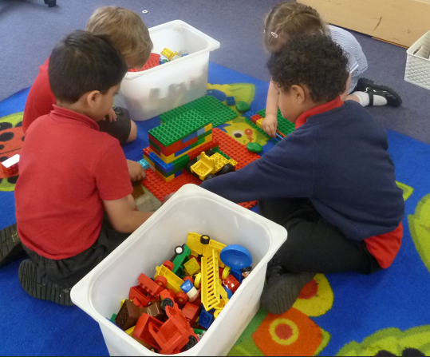
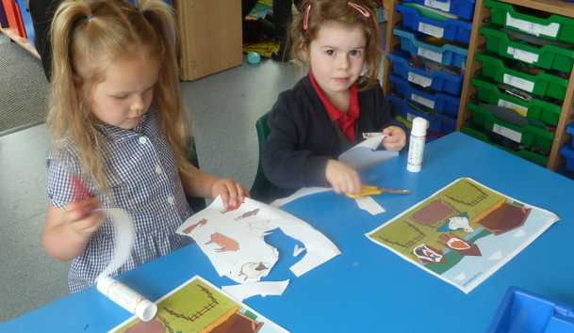
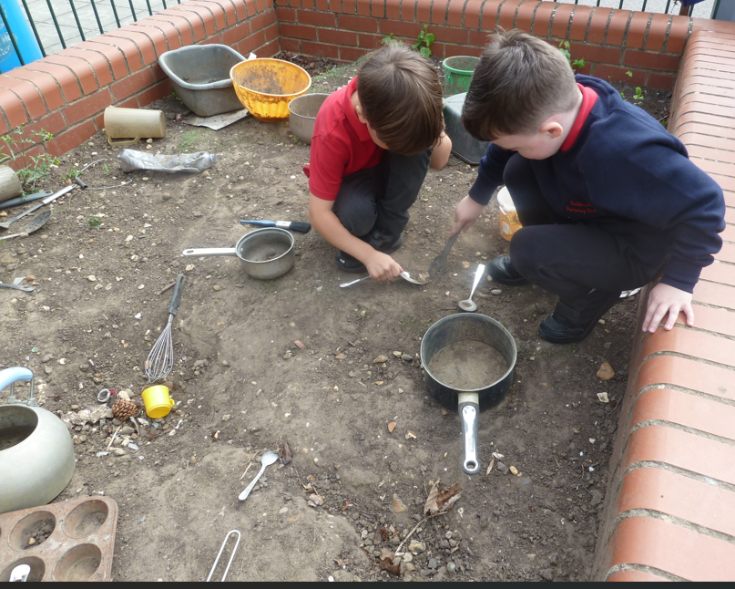
Expectations
In Red Class children are encouraged to be as independent as possible with some adult support. To ensure this, it is helpful if your child can manage their own toilet needs, dress independently (undoing and doing up buttons, managing zips, taking jumpers off and putting back on and doing up their own coats, socks and shoes). Children are often more independent at school than parents think. We give them responsibility for simple routines such as entering the classroom and putting their things away and handing letters to the teacher. Due to time constraints, the staff will not check in their book bags or rucksacks every day.
Work to do at home is provided in Reception. The most important thing to do with your child is to hear them read or read to them every day. Other work for home is in the form of ‘home learning’ tasks e.g. painting a picture of the family, going on a walk and looking for signs of Spring, making a model or learning a song or dance. Details of expectations for children in Red class can be found in the home learning policy. Home learning is a great way for parents and children to work together and it is also a vital element of home–school links.
If you want to help your child outside school, there are websites with useful resources. Little Wandle https://www.littlewandlelettersandsounds.org.uk/resources/for-parents/ Phonics Play www.phonicsplay.co.uk
Literacy and Numeracy games www.ictgames.com

Slide 14
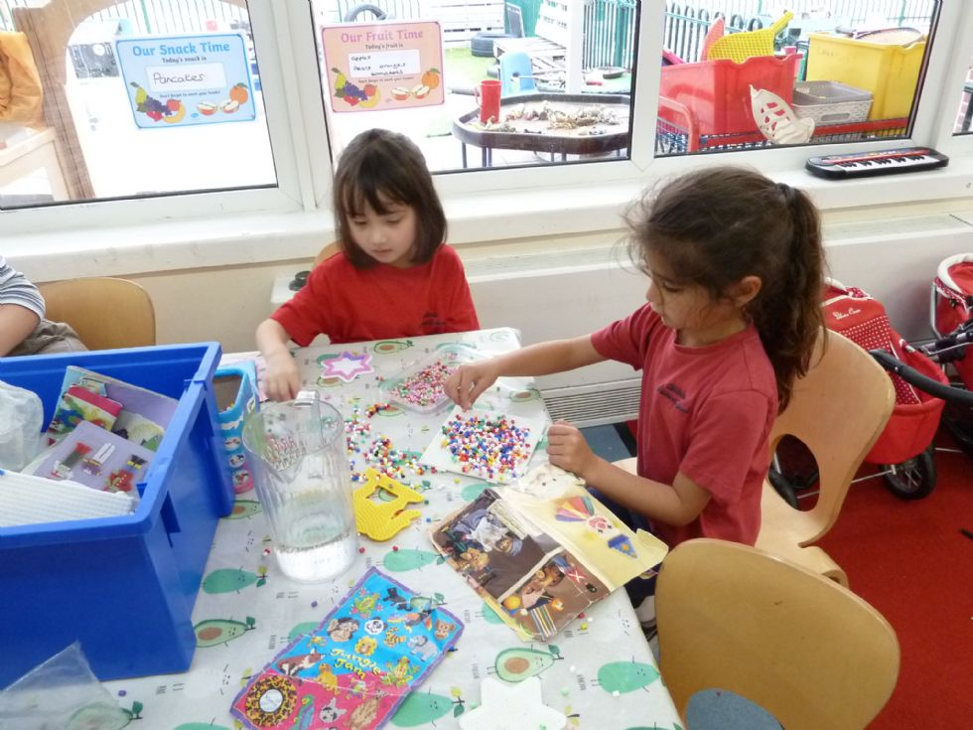
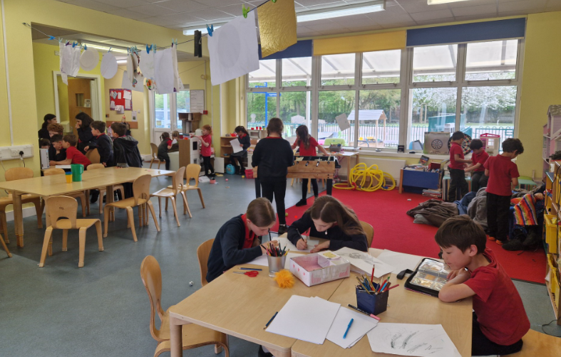
Wrap around care at Careclubs
Wrap around care: our breakfast, after school and holiday club is called CareClubs
Breakfast club: from 7:45am and children are taken to their classroom at the start of school After school club: 3:20 – 6pm Mon-Thurs, 3:20 – 5pm on Friday
Holiday club: Every day 8:30am – 5:30pm (5pm on Fridays). Open all holidays except May half term, 2 weeks during summer and between Christmas and New year.
Staffed by experienced members of the school team the children participate in a number of activities including outside play, messy crafts, cooking, board games, computers, pool table, table football, etc. Daily activities are planned or the children can relax and unwind in our quiet corner after a busy day at school. The outside play area allows children to go outside in most weather conditions.
To register and make a booking please contact: careclubs@caldecote.cambs.sch.uk

Slide 15
How to Get Involved
PTA
The PTA meets every half term to plan fundraising activities for the school. They contribute to the school in a number of ways, from providing extra treats during the school year (such as Christmas crackers and leavers’ presents) to supporting large projects like the purchase of IT equipment.
Every parent is a member of the PTA and is welcome, in fact encouraged, to attend meetings. The PTA always needs help with organising events and coming up with ideas – your school needs you!
Contact: pta@caldecote.cambs.sch.uk.
Parent/Carer volunteers
We actively encourage parents to come and help in school with activities such as reading and general classroom tasks. Please email the office if you have some spare time and would be happy to help in this way.
Governors
The three main roles of the Governing Body are:
to provide a strategic view, setting the aims and objectives for the school each year and monitoring how those objectives are being met by reviewing progress
to hold the school to account for the standards achieved and the quality of provision for the pupils
to act as a 'critical friend' for the Headteacher, providing advice and support.
Our Governing Body is made up a mixture of parent governors, local authority appointed governors and staff governors. All parents are eligible to stand as a parent governor when a vacancy arises.

Slide 16

Term Dates 2026-27
Autumn Term 2026
Tuesday 1st September to Friday 18th December
Half Term: Monday 26th October - Friday 30th October
Training Days: Tuesday 1st September and Wednesday 2nd September
Spring Term 2027
Monday 4th January to Thursday 25th March
Half Term: Monday 15th February -Friday 19th February
Training Days: Monday 4th January
Summer Term 2027
Monday 13th April to Monday 21st July
Public Holiday: Monday 3rd May
Half Term: Monday 31 May - Friday 4 June
Training Days: Monday 12th April and Friday 28th May

Slide 17

Useful forms and links
Free school meal information for all year groups
FSM application forms
HAF - Free holiday activities funding for families who receive free school meals
Holiday Activites and food programme
Universal infant free school meals for all children in KS1
UIFSM
Cool milk for milk orders for the over 5's
Cool milk
Careclubs - Wraparound care and holiday clubs
Careclubs

Slide 18

Request to administer prescription medication
Please contact the school office Request for term time absence Please contact the school office
Contact us
The school office is open Monday to Friday between 8:30am and 3:30pm during term time
You can telephone us on 01954 210263, or email us office@caldecote.cambs.sch.uk or pop in and see us.
Our website: www.caldecoteprimaryschool.org.uk

